Slide 1
Unit – 3 Central Processing Unit

Slide 2
General register-based CPU Organization
When we are using multiple general-purpose registers, instead of a single accumulator register, in the CPU Organization then this type of organization is known as General register-based CPU Organization. In this type of organization, the computer uses two or three address fields in their instruction format. Each address field may specify a general register or a memory word. If many CPU registers are available for heavily used variables and intermediate results, we can avoid memory references much of the time, thus vastly increasing program execution speed, and reducing program size.
Generally CPU has seven general registers. Register organization show how registers are selected and how data flow between register and ALU. A decoder is used to select a particular register. The output of each register is connected to two multiplexers to form the two buses A and B. The selection lines in each multiplexer select the input data for the particular bus.
The A and B buses form the two inputs of an ALU. The operation select lines decide the micro operation to be performed by ALU. The result of the micro operation is available at the output bus. The output bus connected to the inputs of all registers, thus by selecting a destination register it is possible to store the result in it.

Slide 3
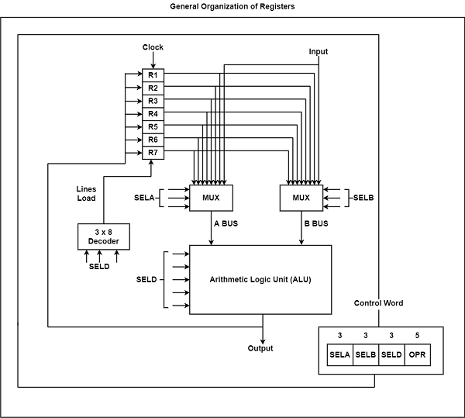
A bus organization for seven CPU register
Example: To perform the operation R3 = R1+R2 We have to provide following binary selection variable to the select inputs
1. SEL A : 001 -To place the contents of R1 into bus A.
2. SEL B : 010 - to place the contents of R2 into bus B
3. SEL OPR : 10010 – to perform the arithmetic addition A+B
4. SEL REG or SEL D : 011 – to place the result available on output bus in R3.

Slide 4
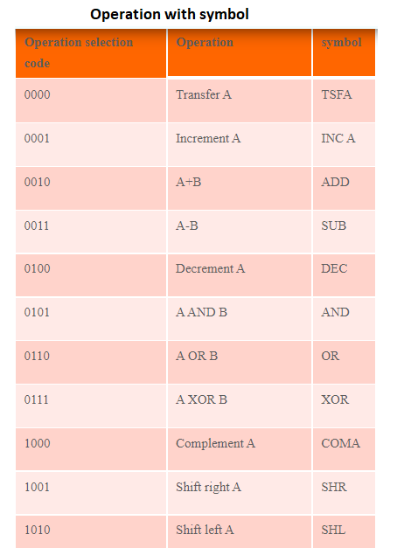
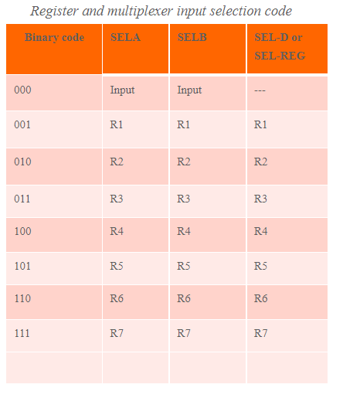

Slide 5


Slide 6
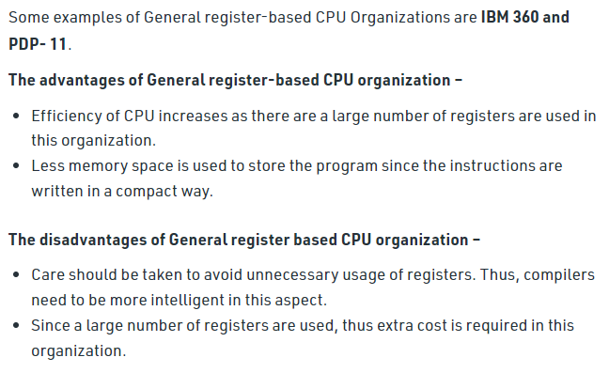

Slide 7
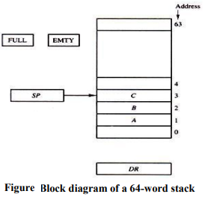
Stack organization:
A stack is a storage device that stores information in such a manner that the item stored last is the first item retrieved.
The stack in digital computers is essentially a memory unit with an address register that can count only. The register that holds the address for the stack is called a stack pointer (SP) because its value always points at the top item in the stack.
The physical registers of a stack are always available for reading or writing. It is the content of the word that is inserted or deleted.
Register stack:
A stack can be placed in a portion of a large memory or it can be organized
as a collection of a finite number of memory words or registers. Figure shows
the organization of a 64- word register stack.
• The stack pointer register SP contains a binary number whose value is
equal to the address of the word that is currently on top of the stack.
Three items are placed in the stack: A, B, and C, in that order. Item C is on
top of the stack so that the content of SP is now 3.

Slide 8
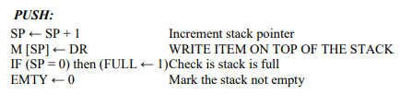
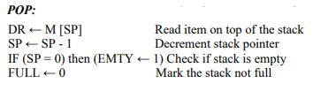
• To remove the top item, the stack is popped by reading the memory word at address 3 and decrementing the content of SP. Item B is now on top of the stack since SP holds address 2.
• To insert a new item, the stack is pushed by incrementing SP and writing a word in the next-higher location in the stack.
• In a 64-word stack, the stack pointer contains 6 bits because 26 = 64.
• Since SP has only six bits, it cannot exceed a number greater than 63 (111111 in binary). When 63 are incremented by 1, the result is 0 since 111111 + 1 = 1000000 in binary, but SP can accommodate only the six least significant bits.
• Similarly, when 000000 is decremented by 1, the result is 111111. The one-bit register FULL is set to 1 when the stack is full, and the one-bit register EMTY is set to 1 when the stack is empty of items.
• DR is the data register that holds the binary data to be written into or read out of the stack.

Slide 9
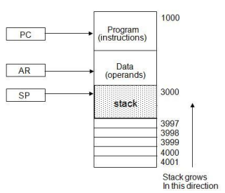
Memory stack
• The implementation of a stack in the CPU is done by assigning a portion of memory to a stack operation and using a processor register as a stack pointer.
• Fig, shows a portion of computer memory partitioned into three segments: program, data, and stack.
• The program counter PC points at the address of the next instruction in the program which is used during the fetch phase to read an instruction.
• The address registers AR points at an array of data which is used during the execute phase to read an operand.
• The stack pointer SP points at the top of the stack which is used to push or pop items into or from the stack.
• The three registers are connected to a common address bus, and either one can provide an address for memory.
• As shown in Fig, the initial value of SP is 4001 and the stack grows with decreasing addresses. Thus the first item stored in the stack is at address 4000, the second item is stored at address 3999, and the last address that can be used for the stack is 3000.
• We assume that the items in the stack communicate with a data register DR.

Slide 10
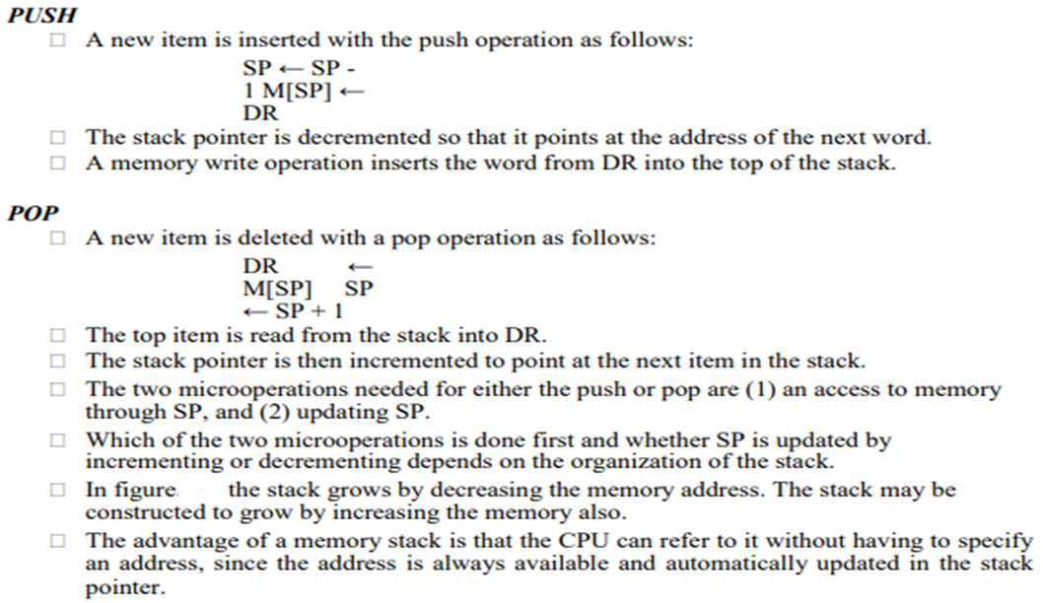

Slide 11
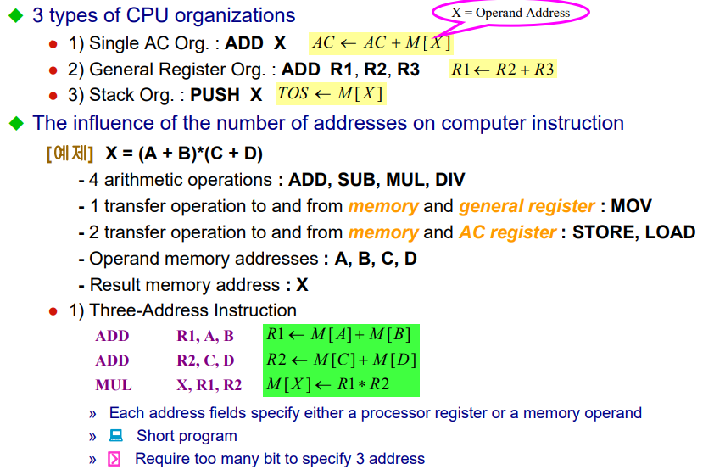

Slide 12
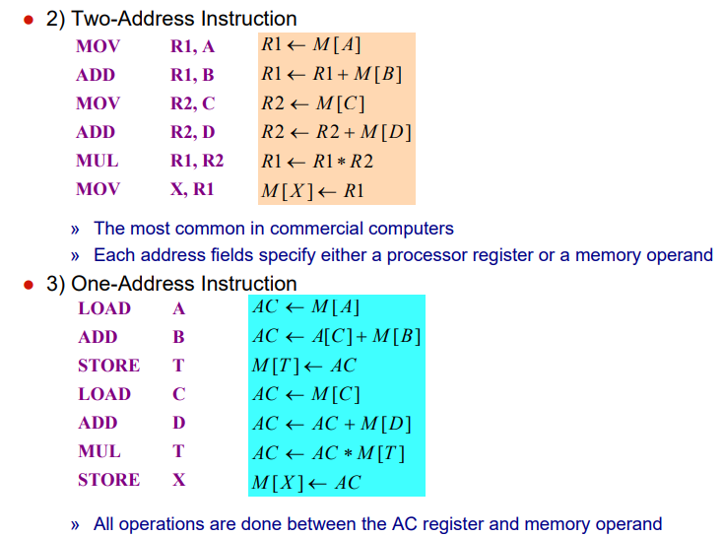

Slide 13
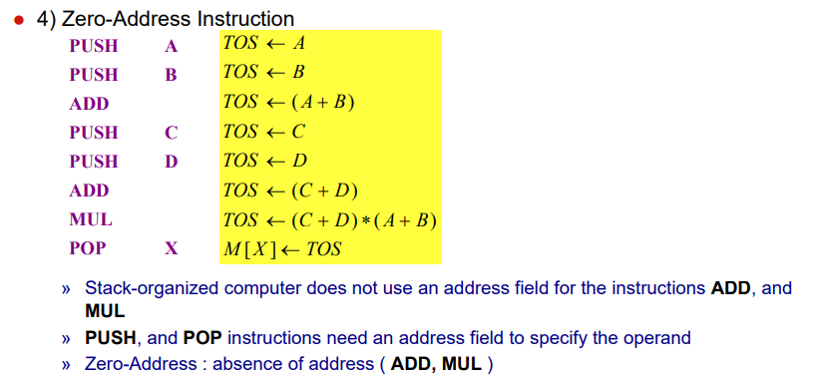

Slide 14
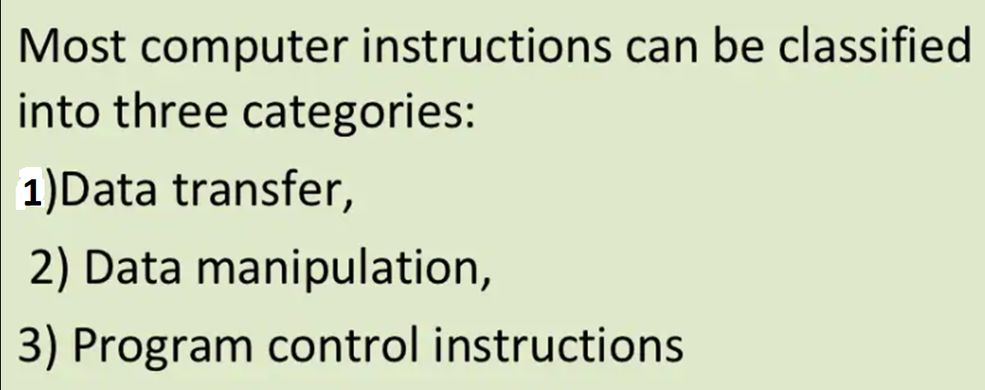
Data Transfer & Manipulation Instruction

Slide 15
1.Data Transfer Instruction

Slide 16
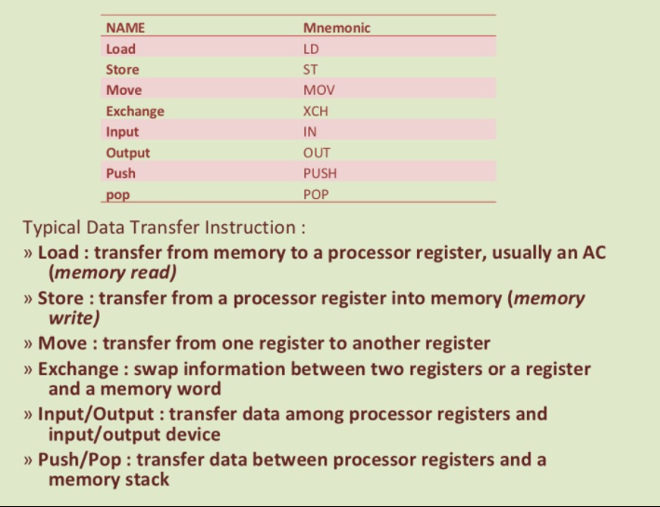

Slide 17
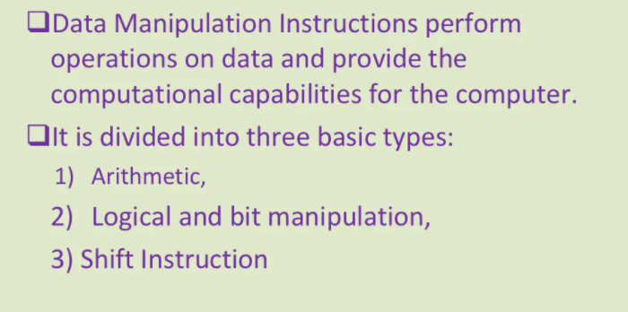
2. Data Manipulation Instruction

Slide 18
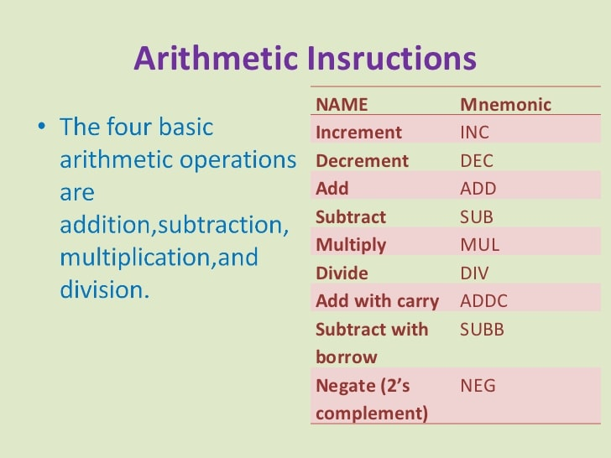

Slide 19
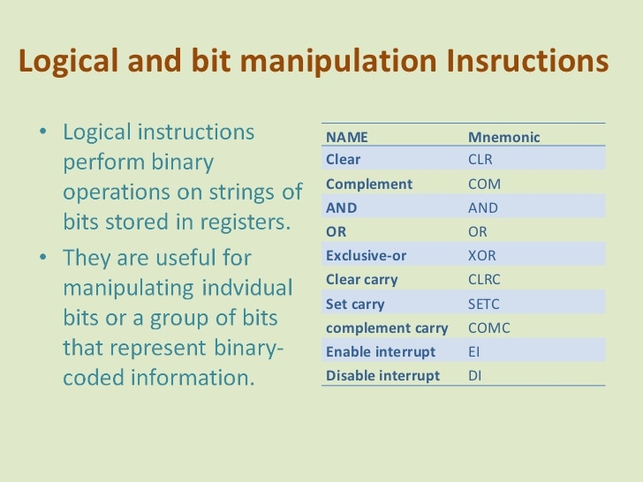

Slide 20
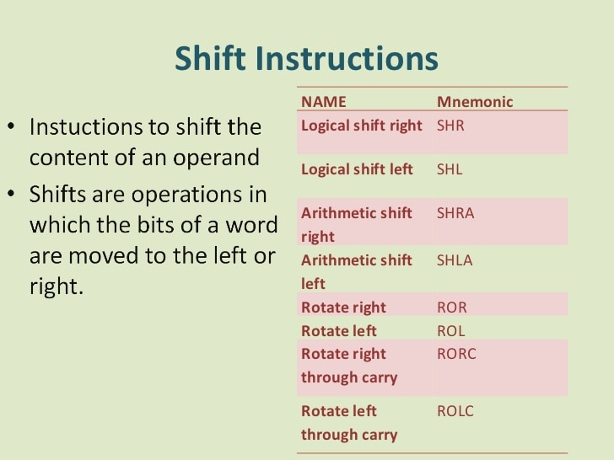

Slide 21
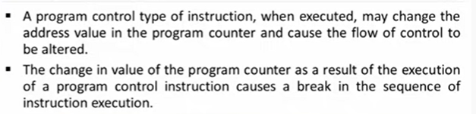
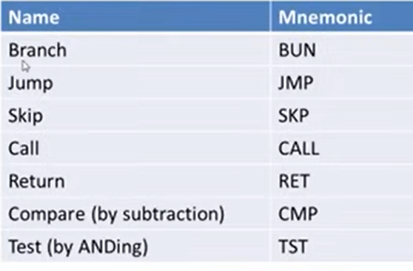
3. Program Control Instruction

Slide 22
Addressing Modes
Addressing Modes– The term addressing modes refers to the way in which the operand of an instruction is specified. The addressing mode specifies a rule for interpreting or modifying the address field of the instruction before the operand is actually executed.
Implied mode
Immediate addressing mode
Register mode
Register Indirect mode
Auto Indexed (increment mode)
Auto indexed ( decrement mode)
Direct addressing Mode
Indirect addressing Mode
Indexed addressing mode
Base register addressing mode

Slide 23


Implied mode
In implied addressing the operand is specified in the instruction itself. In this mode the data is 8 bits or 16 bits long and data is the part of instruction. Zero address and one address instruction are designed with implied addressing mode.
Example: CRC (used to clear Carry flag)
INCA (increment accumulator) AC<- AC+1
CLA (COMPLEMENT THE CARRY FLAG
ADD
Immediate addressing mode (symbol #):
In this mode data is present in address field of instruction .Designed like one address instruction format. Note: Limitation in the immediate mode is that the range of constants are restricted by size of address field.
Example: 1 MOV AL, 35H (move the data 35H into AL register)
2 ADD R1, #3 (R1 ← R1+3)

Slide 24


Register mode:
In register addressing the operand is placed in one of 8 bit or 16 bit general purpose registers. The data is in the register that is specified by the instruction.
Example: MOV AX,CX (move the contents of CX register to AX register)
LD R₁ (AC <- R₁ )
Register Indirect mode: Register contain address of operand rather than operand itself.
In this addressing the operand’s offset is placed in any one of the registers BX,BP,SI,DI as specified in the instruction. The effective address of the data is in the base register or an index register that is specified by the instruction. Here two register reference is required to access the data.
EX.
MOV AX, [BX] (move the contents of memory location s addressed by the register BX to the register AX)
ADD R₁ , ( R₂ ) (R1 ← R1 +M [ ( R2 ) ]

Slide 25
Auto Indexed (increment mode): Effective address of the operand is the contents of a register specified in the instruction. After accessing the operand, the contents of this register are automatically incremented to point to the next consecutive memory location.(R1)+.
EX. Add R1, (R2)+
R1 = R1 +M[R2]
R2 = R2 + d
Auto indexed ( decrement mode): Effective address of the operand is the contents of a register specified in the instruction. Before accessing the operand, the contents of this register are automatically decremented to point to the previous consecutive memory location. –(R1).
EX: Add R1,-(R2)
R2 = R2-d
R1 = R1 + M[R2]

Slide 26

Direct addressing/ Absolute addressing Mode (symbol [ ]): The operand’s offset is given in the instruction as an 8 bit or 16 bit displacement element. In this addressing mode the 16 bit effective address of the data is the part of the instruction. Here only one memory reference operation is required to access the data.
Example: 1. ADD AL,[0301] //add the contents of offset address 0301 to AL
2. ADD X // AC ← AC + M[X]
3. LD 400 // AC ← M[400]

Slide 27
Indirect addressing Mode (symbol @ or () ):
In this mode address field of instruction contains the address of effective address.
Here two references are required. 1st reference to get effective address. 2nd reference to access the data. Based on the availability of Effective address, Indirect mode is of two kind:
Register Indirect: In this mode effective address is in the register, and corresponding register name will be maintained in the address field of an instruction. Here one register reference, one memory reference is required to access the data.
Memory Indirect: In this mode effective address is in the memory, and corresponding memory address will be maintained in the address field of an instruction. Here two memory reference is required to access the data.
EX: ADD X // AC ← M[M[X]]

Slide 28
Indexed addressing mode:
Use to access or implement array efficiently.
Multiple register required to implement.
Any element can be accessed without changing instruction.
EA= Base register + IR
BASE REGISTER ADDRESS=100
100 | 101 | 102 | 103 | 104
Example: MOV AX, [SI +05]
MOV AX, [SI +04]
Base register addressing mode:
“Used in program relocation” Base register addressing mode is used to implement inter segment transfer of control. In this mode effective address is obtained by adding base register value to address field value.
EA= Base register + Address field value(Displacement)

Slide 29
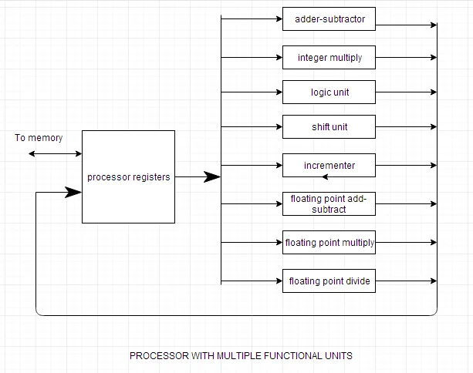
Parallel Processing
Instead of processing each instruction sequentially, a parallel processing system provides concurrent data processing to increase the execution time.
In this the system may have two or more ALU's and should be able to execute two or more instructions at the same time. The purpose of parallel processing is to speed up the computer processing capability and increase its throughput.
NOTE: Throughput is the number of instructions that can be executed in a unit of time.
Parallel processing can be viewed from various levels of complexity. At the lowest level, we distinguish between parallel and serial operations by the type of registers used. At the higher level of complexity, parallel processing can be achieved by using multiple functional units that perform many operations simultaneously.

Slide 30
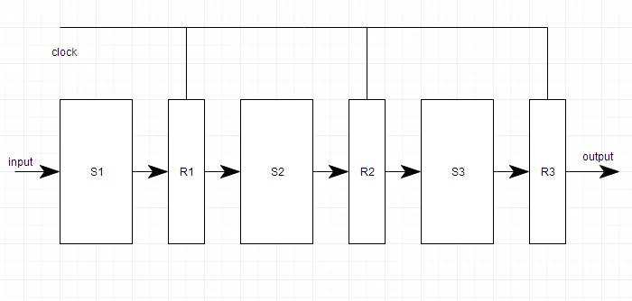
Pipelining
Pipelining is the process of accumulating instruction from the processor through a pipeline. It allows storing and executing instructions in an orderly process. It is also known as pipeline processing.
Pipelining is a technique where multiple instructions are overlapped during execution. Pipeline is divided into stages and these stages are connected with one another to form a pipe like structure. Instructions enter from one end and exit from another end.
Pipelining increases the overall instruction throughput.
In pipeline system, each segment consists of an input register followed by a combinational circuit. The register is used to hold data and combinational circuit performs operations on it. The output of combinational circuit is applied to the input register of the next segment.

Slide 31
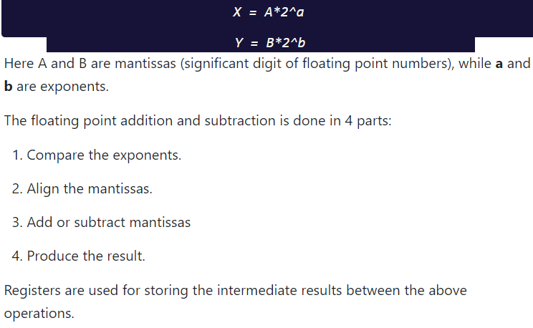
Pipeline system is like the modern day assembly line setup in factories. For example in a car manufacturing industry, huge assembly lines are setup and at each point, there are robotic arms to perform a certain task, and then the car moves on ahead to the next arm.
Arithmetic Pipeline
Arithmetic pipelines are usually found in most of the computers. They are used for floating point operations, multiplication of fixed point numbers etc. For example: The input to the Floating Point Adder pipeline is:

